Slide 2
Docker installation
Download the installation file for MAC-OSX.
Download the installation file for Windows.

Slide 3
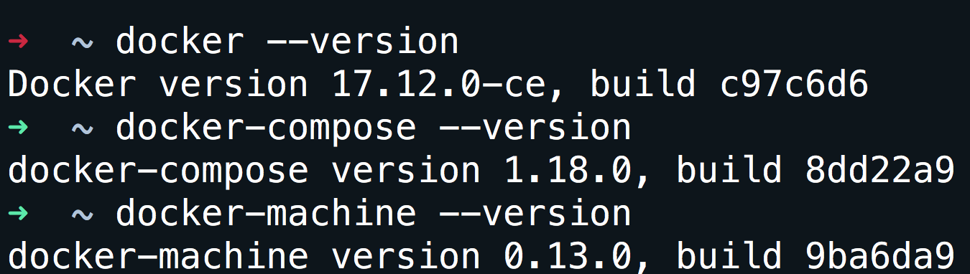
Verify installation
docker --version

Slide 4
Don’t want to install that is ok.
Open your browser and go to: https://labs.play-with-docker.com/

Slide 5
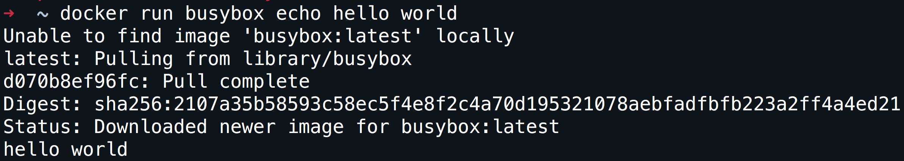
Run your first container
docker run busybox echo hello world

Slide 6
What did we just do
We download the smallest and simplest image from a repo.
We executed the command hello world.

Slide 7
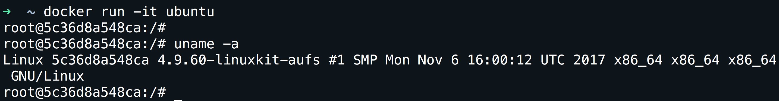
A more useful container
docker run -it ubuntu
-it is shorthand for -i -t.
-i tells Docker to connect us to the container's stdin.
-t tells Docker that we want a pseudo-terminal.

Slide 8
A few concepts
Images.
Volumes.
Network.
Containers.

Slide 9
Images
What is an image.
What is a layer.
The various image namespaces.
How to search and download images.
Image tags and when to use them.

Slide 10
What is an image
Image = files + metadata
Images are made of layers, conceptually stacked on top of each other.
Each layer can add, change, and remove files and/or metadata.
Images can share layers to optimize disk usage, transfer times, and memory use.
The images are a read-only filesystem.

Slide 11
Object-oriented programming
Images are conceptually similar to classes.
Layers are conceptually similar to inheritance.
Containers are conceptually similar to instances.

Slide 12
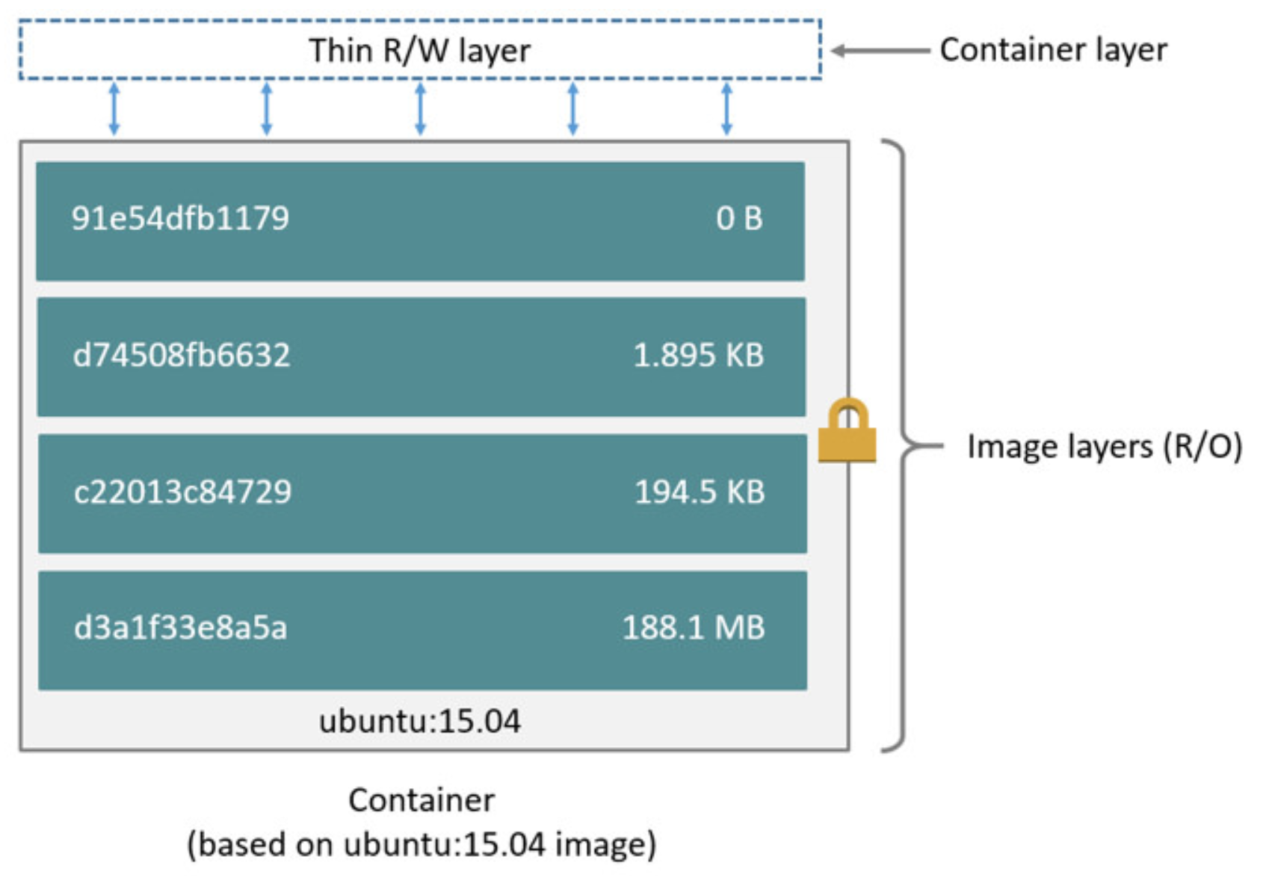
How an image looks like

Slide 13
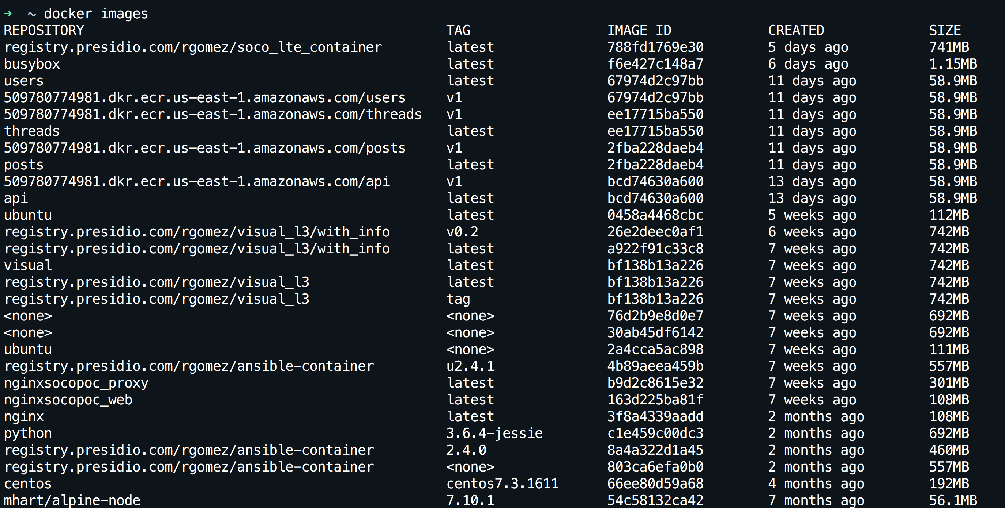
How can I see my images
docker images

Slide 14
Wait a minute…The image is read-only???!!!
We don't.
We create a new container from that image.
Then we make changes to that container.
When we are satisfied with those changes, we transform them into a new layer.
A new image is created by stacking the new layer on top of the old image.

Slide 15
How do we update an image
docker commit
Saves all the changes made to a container into a new layer.
Creates a new image (effectively a copy of the container).
docker build
Performs a repeatable build sequence.
This is the preferred method!

Slide 16
Dockerfile
vi dockerfile
Inside the file copy:
FROM ubuntu
RUN apt-get update
RUN apt-get install figlet
Save the file
docker build -t figlet .
docker images
docker run -ti figlet figlet HELLO

Slide 17
Extending Dockerfile
If the container is normally one process can we add that process into the image?
Using CMD and ENTRYPOINT.
These commands allow us to set the default command to run in a container.

Slide 18
New Dockefile with processes
To the previous dockerfile add at the end:
CMD figlet HELLO
Save the file.
docker build -t figlet-cmd .
docker run -ti figlet-cmd

Slide 19
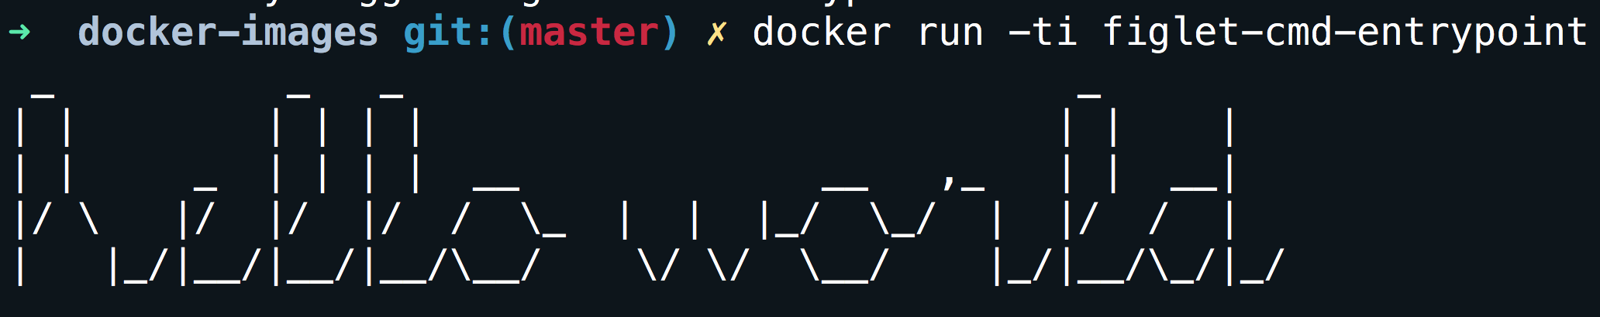
CMD vs ENTRYPOINT
CMD is the last resort to execute a process, if no process is specified during the container creation (docker run -it figlet bash) or no ENTRYPOINT is specified the CMD process is used.
CMD can complement ENTRYPOINT, if both are specified the ENTRYPOINT is the command while the CMD is the argument of the command. For example using:
ENTRYPOINT ["figlet", "-f", "script"]
CMD ["hello world"]
Is going to print:

Slide 20
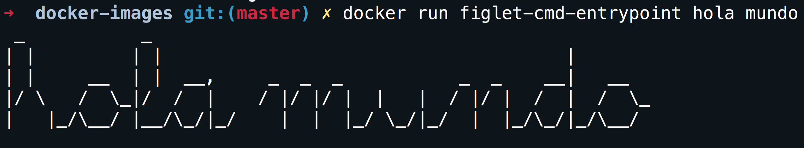
Overriding parameters
Executing docker run figlet hola mundo on the same image:

Slide 21
How do I copy my files
What good is a container if we can not copy our own files.
For the purpose the COPY SOURCE DESTINATION command exist.
A build context is needed
IMPORTANT: the build context is the directory containing the Dockerfile.

Slide 22
NGINX image
Create a new dockerfile-nginx with the following information:
FROM nginx:1.13-alpine
COPY nginx-conf/index.html /usr/share/nginx/html/
Create a new directory:
mkdir nginx-conf
Create an index:
echo "HELLO PRESIDIO" >> nginx-conf/index.html
Build the image and name the image mynginx.
docker build -f dockerfile-nginx -t mynginx .

Slide 23
Say HELLO PRESIDIO
Run the image:
docker run -d -P --name web1 my_nginx:latest
Find the port:
docker port web1
Go to your browser:
http://localhost:<PORT>

Slide 24
Don’t lose your container, share it.
Login to dockerhub
docker login
Use the correct tag in your container:
docker tag mynginx dockehub_username/test_nginx:v1
Push your container:
docker push dockehub_username/test_nginx:v1
Delete your image from your hard-drive.
docker image rm dockehub_username /test_nginx:v1
Verify the image is not longer present:
docker images
Download the image again:
docker pull dockehub_username /test_nginx:v1

Slide 25
http://qconsf2017intro.container.training/#219

